Slide 1


Azure Databricks
Exploring Data Engineering
Maruti Makwana

Slide 2
Building Blocks
Skew
Spill
Shuffle

Slide 3
What is Skewed Data?
Skewness is the statistical term, which refers to the value distribution in a given dataset. When we say that there is highly skewed data, it means that some column values have more rows and some very few, i.e., the data is not properly/evenly distributed

Slide 4
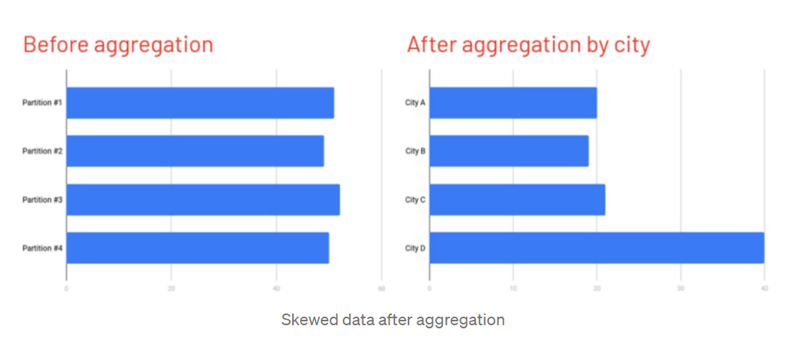
Data is typically read in 128 MB partitions and evenly distributed
As the data is aggregated, its possible to have significantly more records in one partition than other
Large skew can result in spill or worse
If City D is larger than A,B and C….
It takes 2x as long to process the data
It requires 2x as much RAM
The Entire stage will take as long as the longest running task
We may not have enough RAM for these skewed partitions

Slide 5
Skew – Mitigation(solution)
Employ a Databricks-specific skew hint
Enable Adaptive Query Execution
Salting is another way that helps you to manage data skewness at the cost of extra processing

Slide 6
What is Spill?
Spill is the term used to refer to the act of moving an RDD from RAM to disk, and later back into RAM again
This occurs when a given partition is simply too large to fit into RAM
In this case, Spark is forced into expensive disk reads and writes to free up local RAM
Common causes for spill problem:
Set spark.sql.files.maxPartitionBytes to high (default is 128 MB)
The explode() of even a small array
The join() or crossJoin() of two tables creates very large partitions
Aggregating results by a skewed feature can cause single partition to blow beyond what the executor is capable of handling

Slide 7
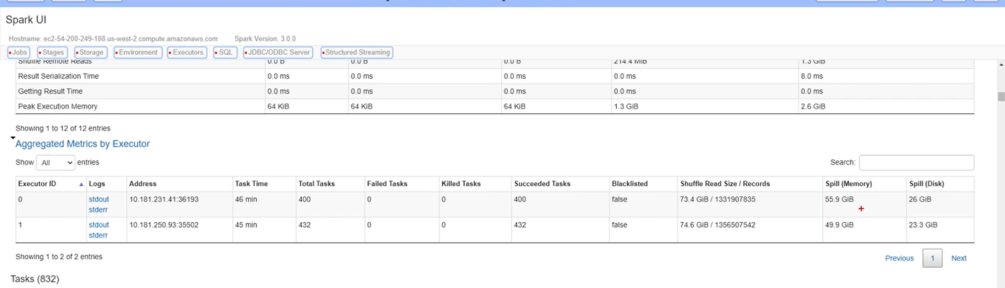
In the Spark UI, spill is represented by two values:
● Spill (Memory): For the partition that was spilled, this is the size of that data as it existed in memory
● Spill (Disk): Likewise, for the partition that was spilled, this is the size of the data as it existed on disk
The size on disk will always be smaller due to the natural compression gained in the act of serializing that data before writing it to disk

Slide 8
● When no spill is present, the corresponding columns don’t even appear in the Spark UI - that means if the column is there, there is spill somewhere
Identify spills using Spill Listener
The SpillListener is a type of SparkListener and tracks when a stage spills
Useful to identify spill in a job when you are not looking for it
Spill listner can be used to listen to the job events that are completed

Slide 9
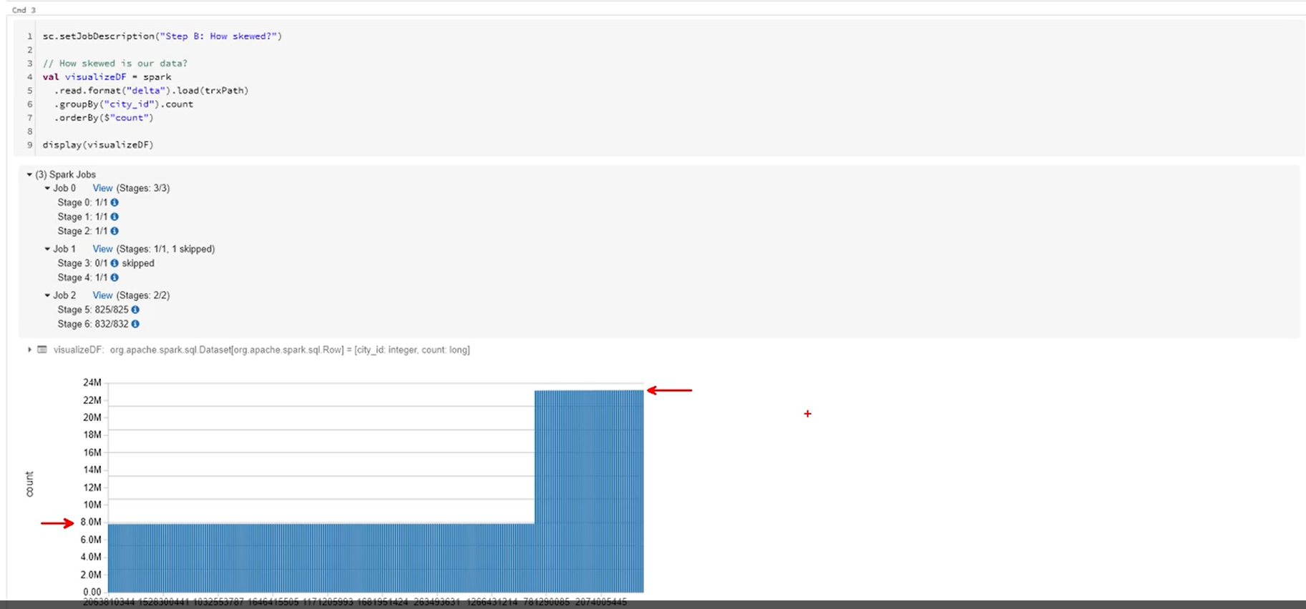
If you look at the plot below most majority of data coming from 8m, but there also significant amount of skewed record

Slide 10
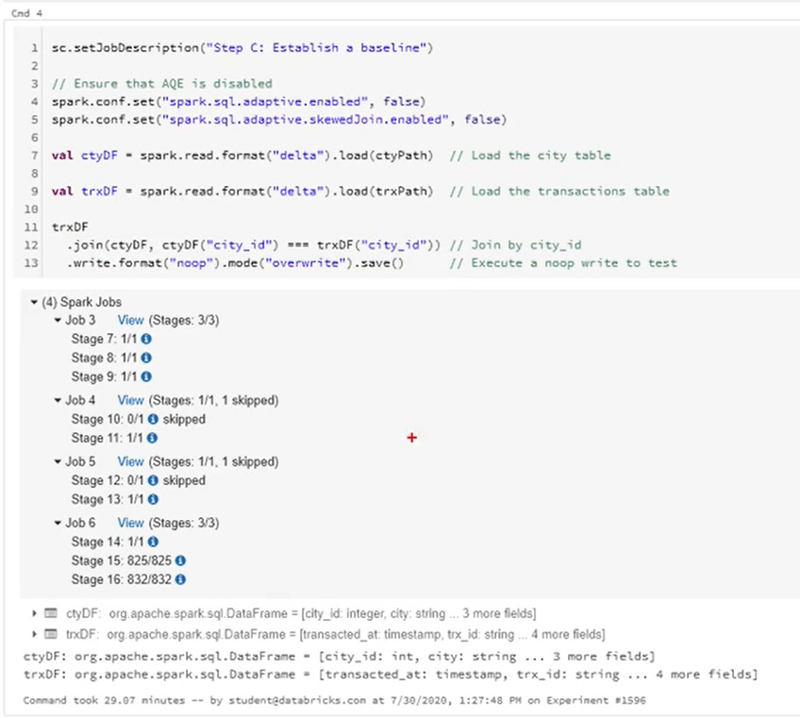
Baseline – it is a code which you want to execute without any optimization technique

Slide 11
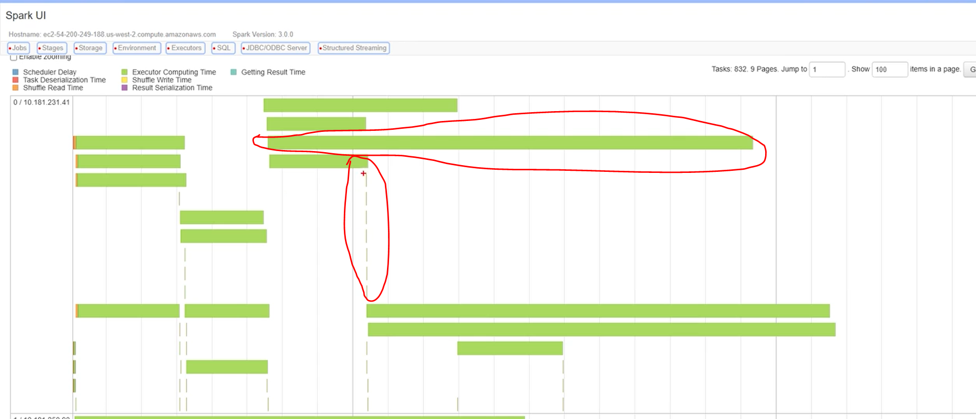
Event timeline of the tasks :
It represents the distribution of records across the partitions. If you look at the vertical highlighted red area,
Task assigned to partition with zero record, literally we have empty partitions or very small partition and
horizontally area : they are massive in terms of time they are taking. We can pretty much assert that these are taking long times
These are the task for partition for which there is a large skew.

Slide 12
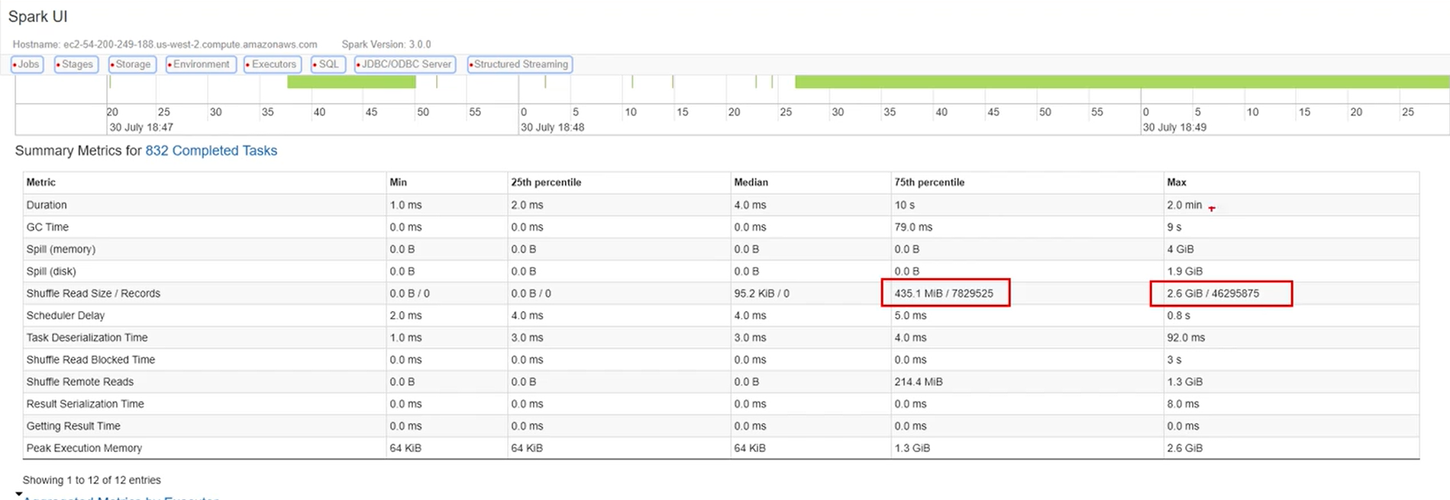
Summary Metric:
If we look at the 25 and 50th percentile, partition is almost empty and if u look at the max the partition size is too huge

Slide 13
Baseline : we spilled over 55.9 GB by Executor 1 into disk and 49.9 GB by another executor

Slide 14
There are 2 ways to optimize
1 Skew hint
2 Adaptive query execution

Slide 15
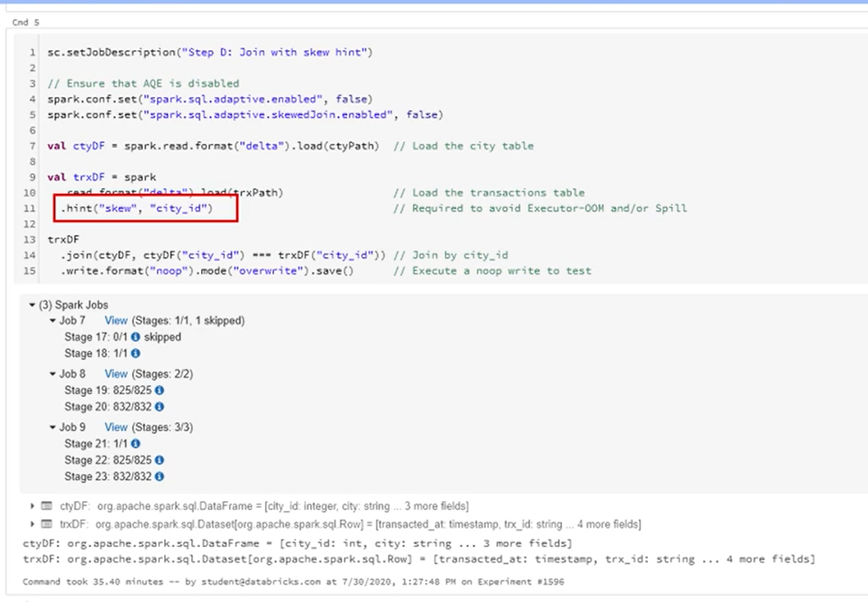
Optimization 1: skew hint
Here we specify that city_id is skewed on trxDf dataset

Slide 16
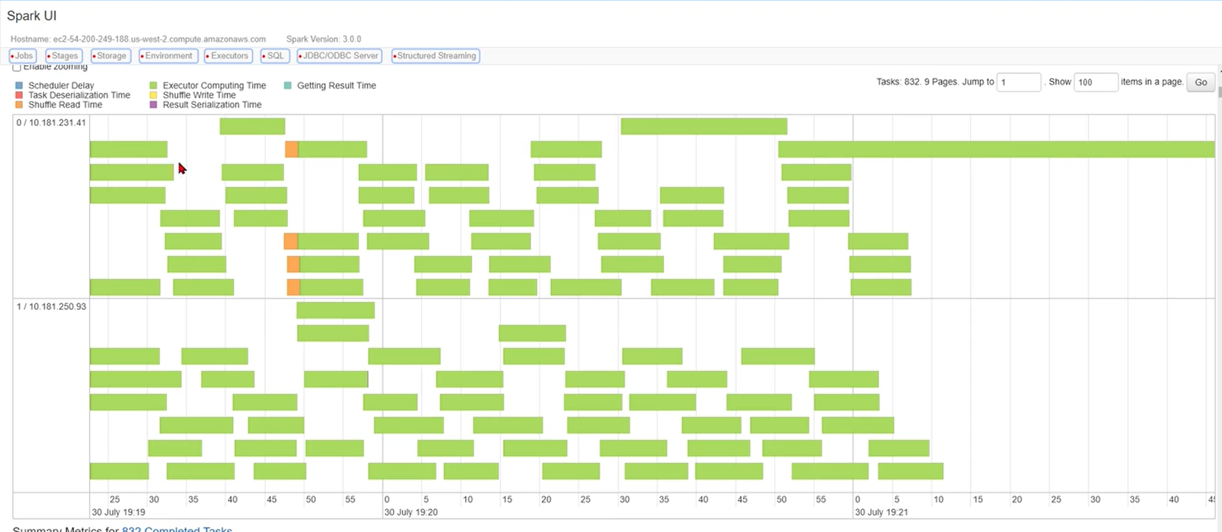
With the help of skew hint tasks are much more evenly distributed

Slide 17
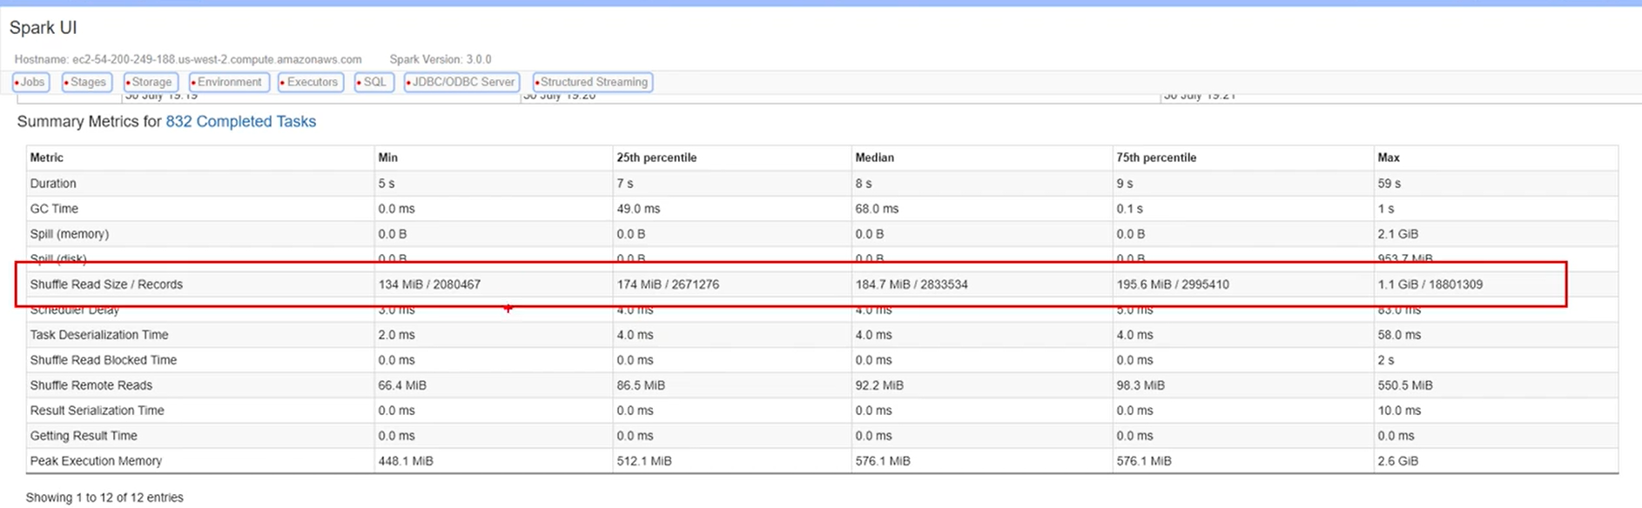
Analysis
Though skew hint took much more time to execute compared to baseline, its very healthy there is a very minimal chances of getting out of memory issue
Skew hint has done a good job in distributing the partition
repartitioning or evenly distribution of data getting performance hit

Slide 18
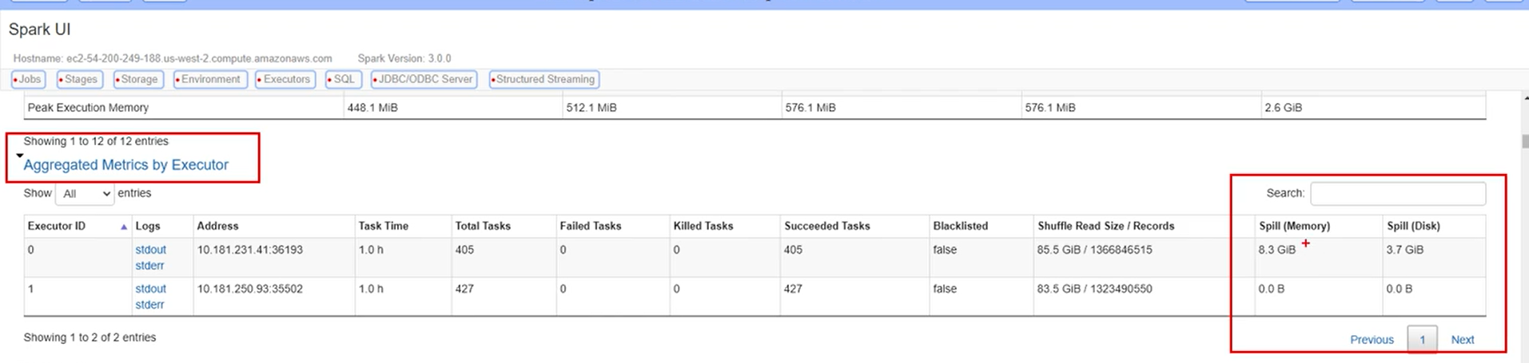
Skew hint : it has only 8gb of data going into disk

Slide 19
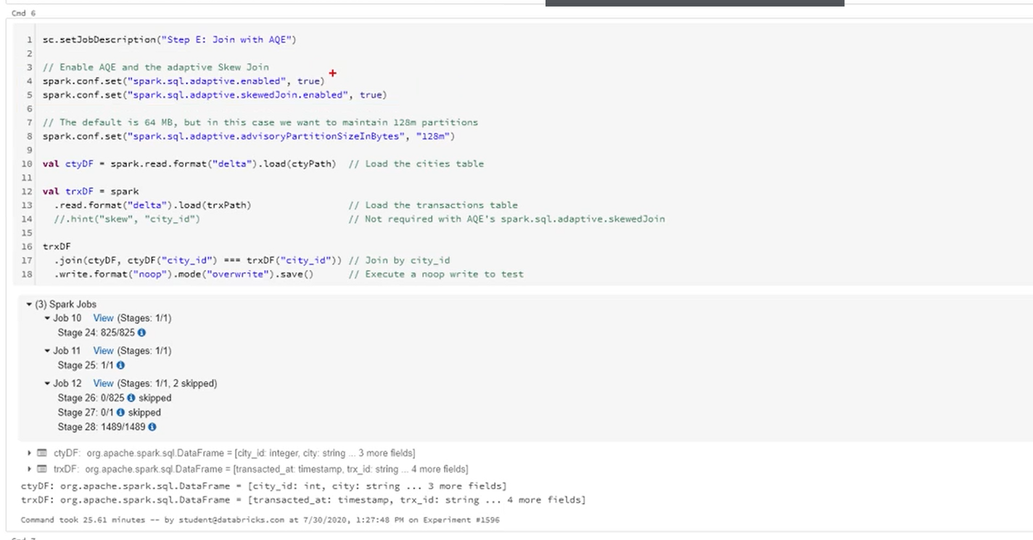
Let's compare baseline with adaptive query execution

Slide 20
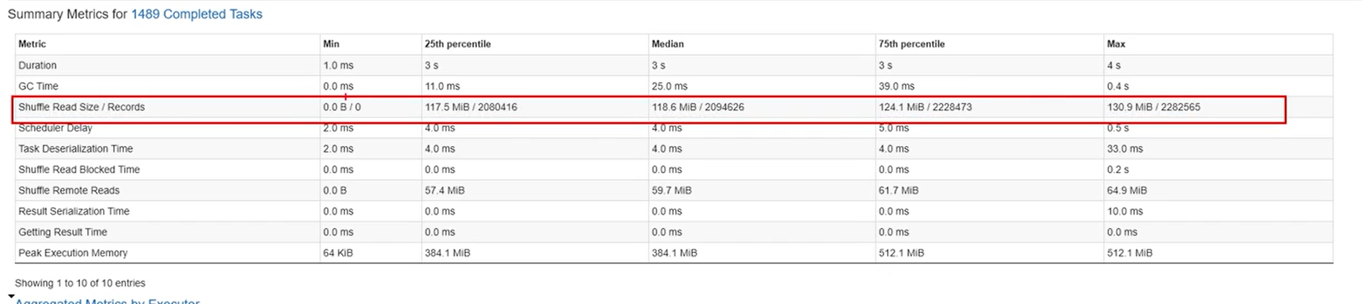
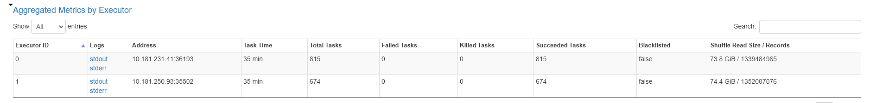
Here partitions are really evenly distributed

Slide 21
What is Spill?
Spill is the term used to refer to the act of moving an RDD from RAM to disk, and later back into RAM again
This occurs when a given partition is simply too large to fit into RAM
In this case, Spark is forced into expensive disk reads and writes to free up local RAM
Common causes for spill problem:
Set spark.sql.files.maxPartitionBytes to high (default is 128 MB)
The explode() of even a small array
The join() or crossJoin() of two tables creates very large partitions
Aggregating results by a skewed feature can cause single partition to blow beyond what the executor is capable of handling

Slide 22
In the Spark UI, spill is represented by two values:
● Spill (Memory): For the partition that was spilled, this is the size of that data as it existed in memory
● Spill (Disk): Likewise, for the partition that was spilled, this is the size of the data as it existed on disk
The size on disk will always be smaller due to the natural compression gained in the act of serializing that data before writing it to disk

Slide 23
● When no spill is present, the corresponding columns don’t even appear in the Spark UI - that means if the column is there, there is spill somewhere
Identify spills using Spill Listener
The SpillListener is a type of SparkListener and tracks when a stage spills
Useful to identify spill in a job when you are not looking for it
Spill listner can be used to listen to the job events that are completed

Slide 24
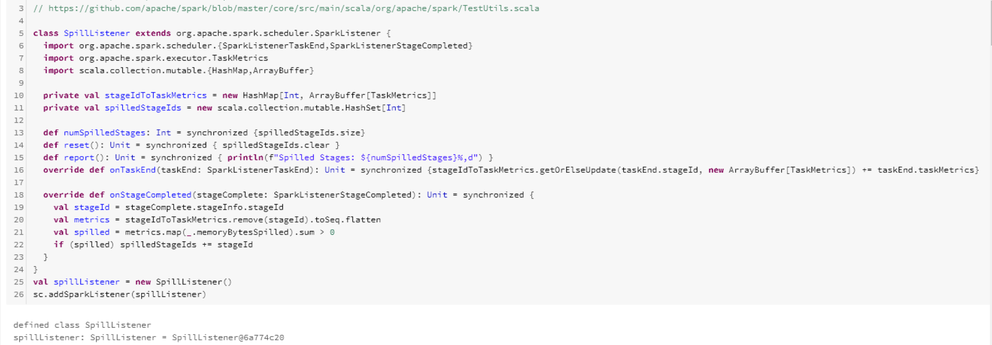
Spill Listener code

Slide 25
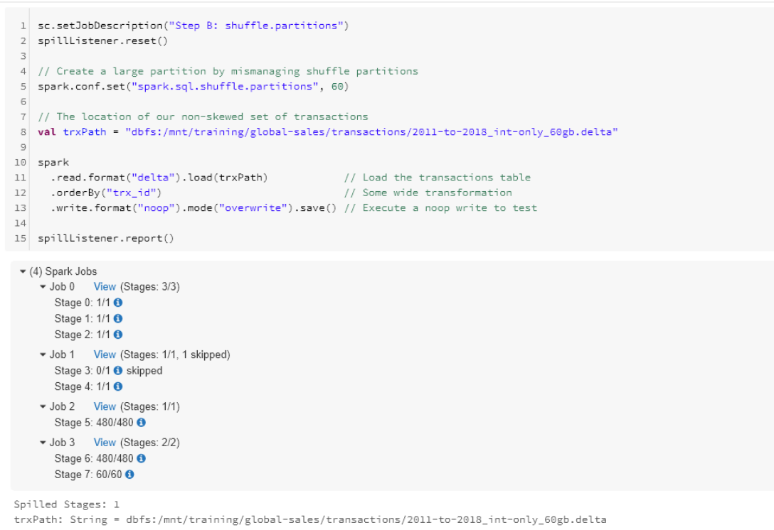
Order By opearation

Slide 26
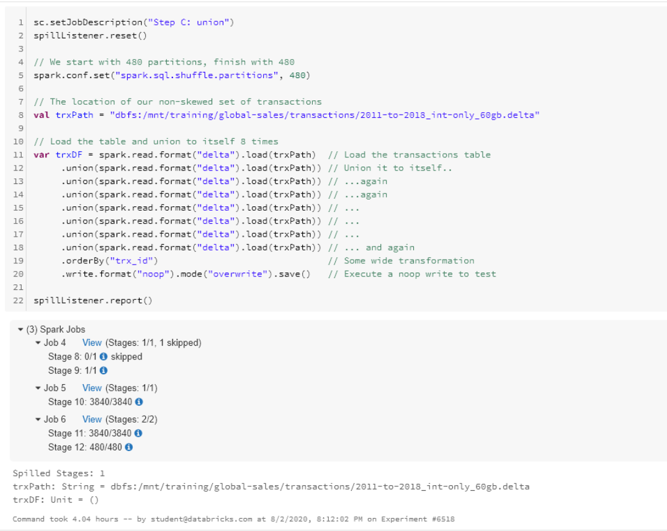
UNION Operation

Slide 27
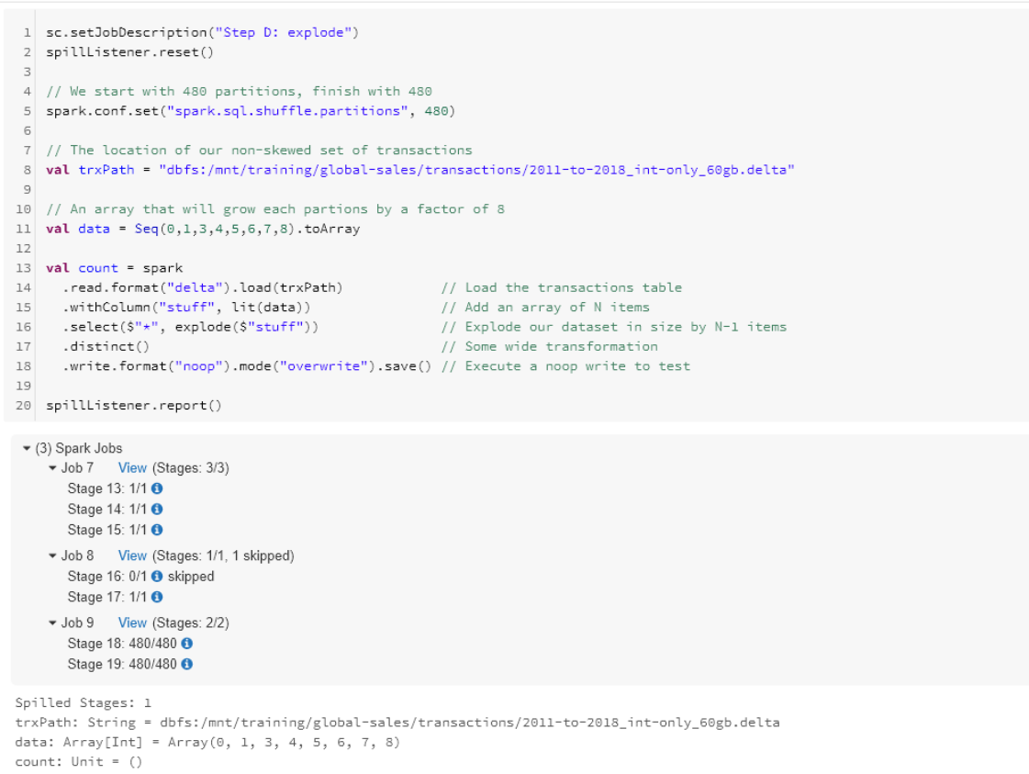
Explode operation

Slide 28
How do we mitigate SPILL?
allocate a cluster with more memory per worker
Decrease the size of each partition by increasing the number of partitions
By managing spark.sql.shuffle.partitions
By explicitly repartitioning
By managing spark.sql.files.maxPartitionBytes

Slide 29
What is shuffle?
Shuffling is a side effect of wide transformation:
join()
distinct()
groupBy()
orderBy() and handful of others
These opeartion employs multi-stage process taking the performance hit

Slide 30
Let’s take a look at how a shuffle works...

Slide 31
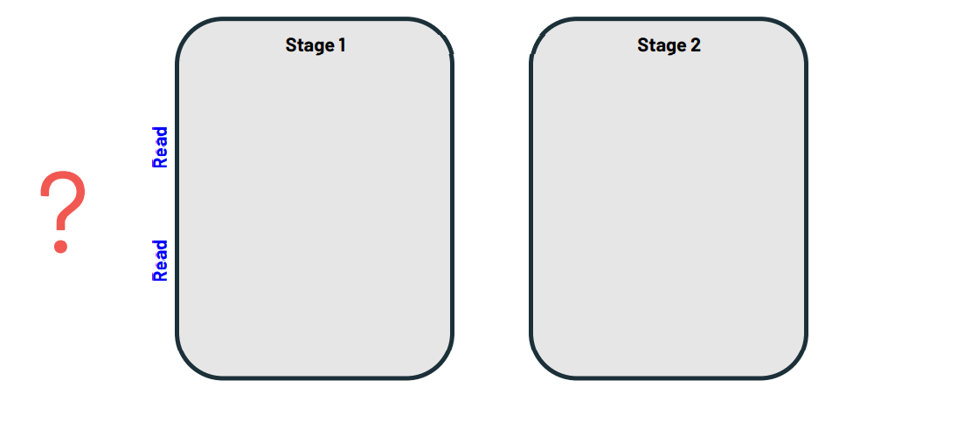
Step #1: Read in data From source or another stage

Slide 32
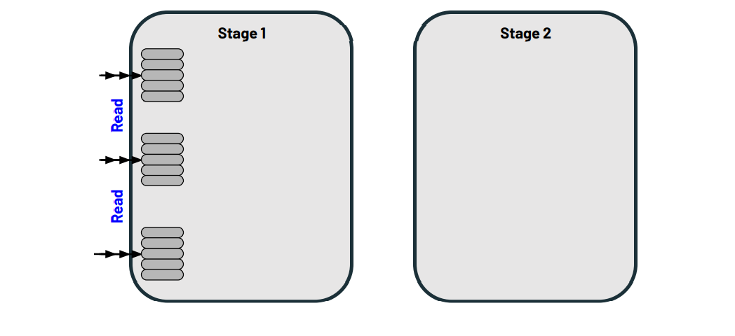
Step #2: Read the data into Spark-Partitions

Slide 33
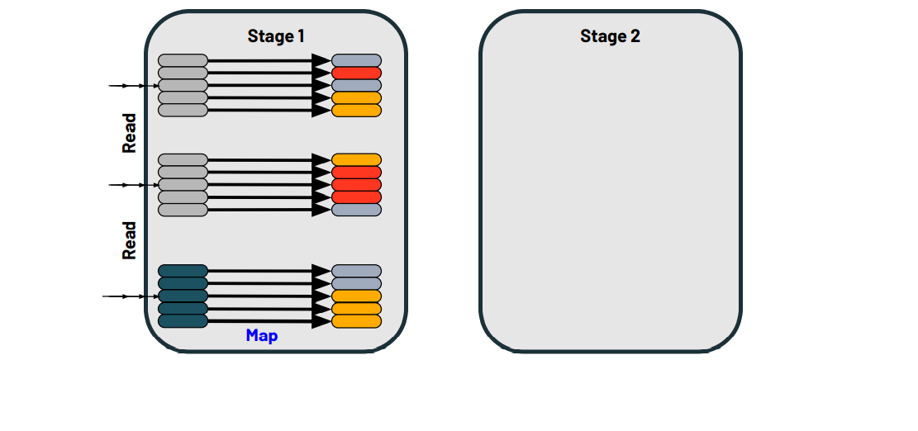
Step #3: Map reach record (e.g. by key) to a new partition

Slide 34
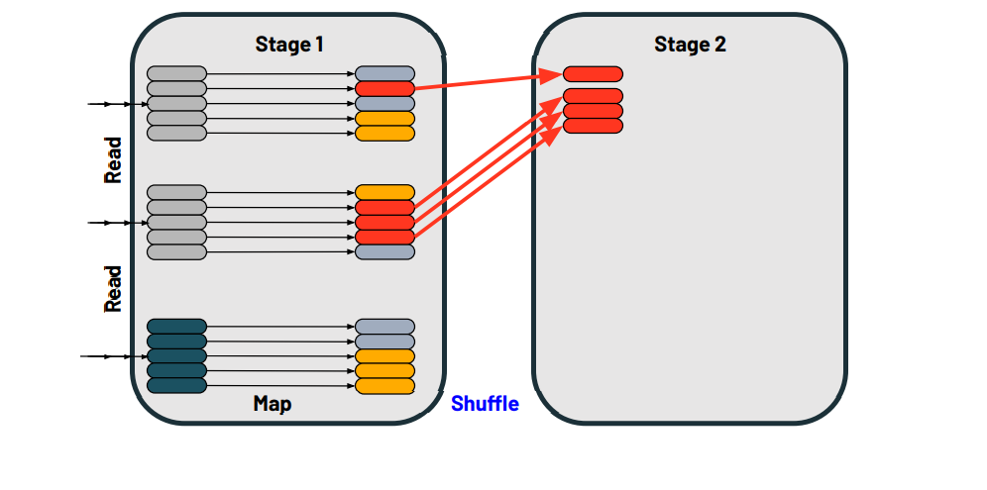
Step #4-A: Read the shuffle files into the next stage

Slide 35
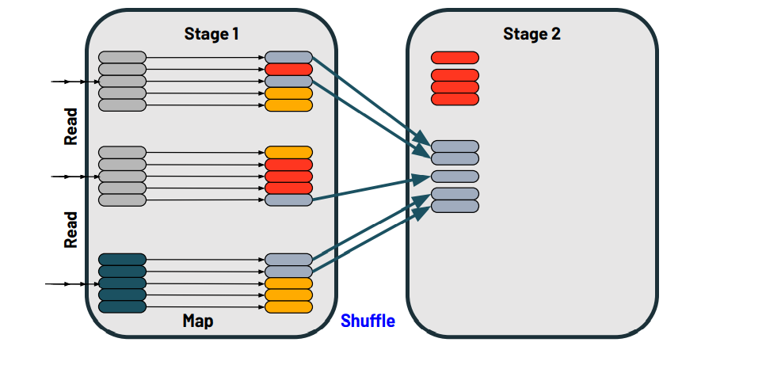

Slide 36
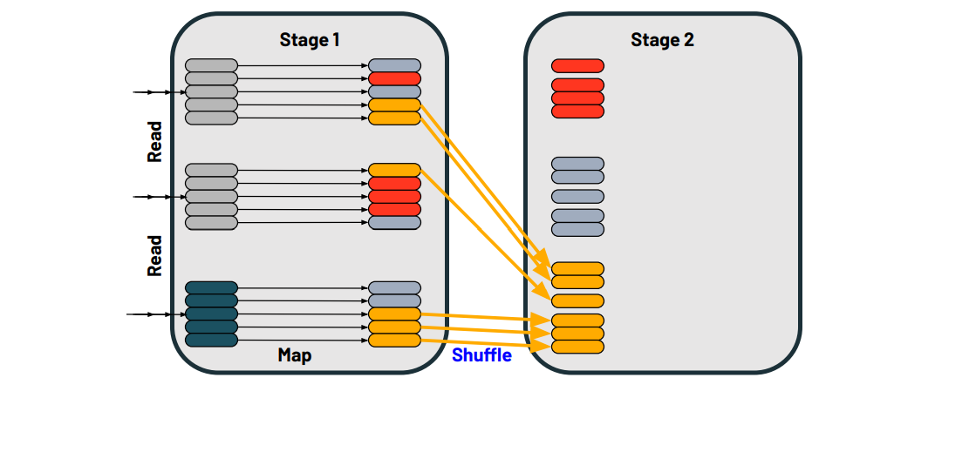

Slide 37
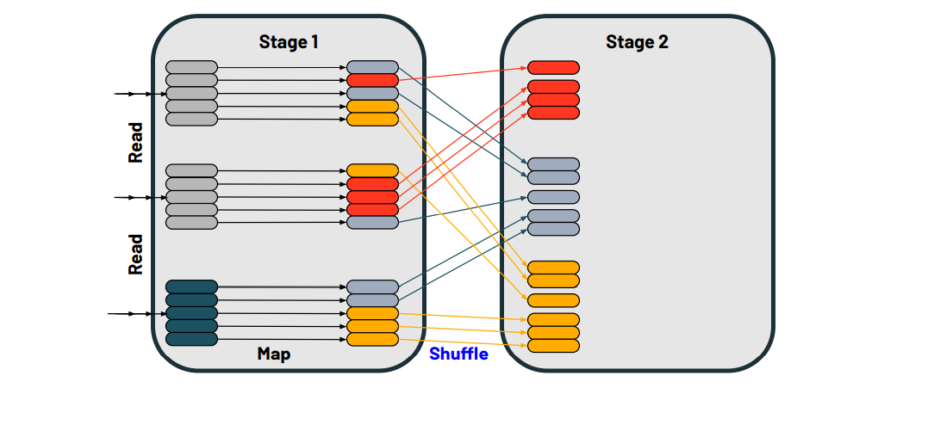

Slide 38
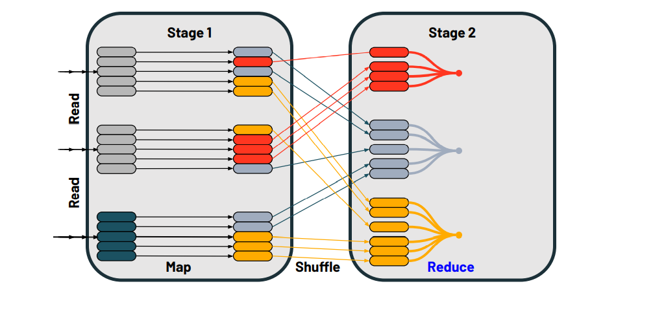
Now we are gonna perform the reduce operation

Slide 39
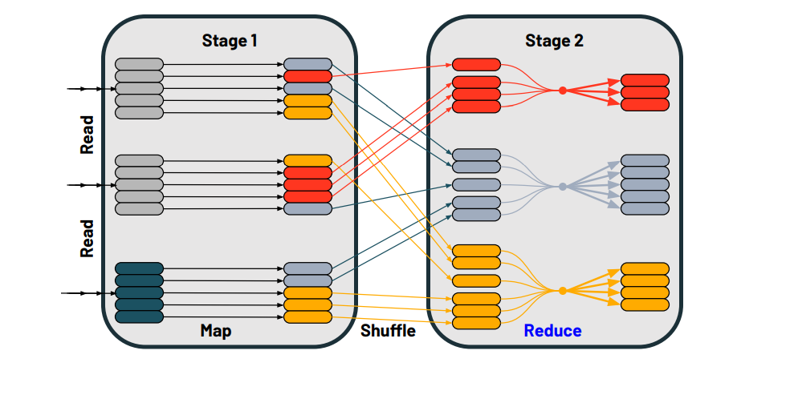
The final result is a new set of partitions

Slide 40
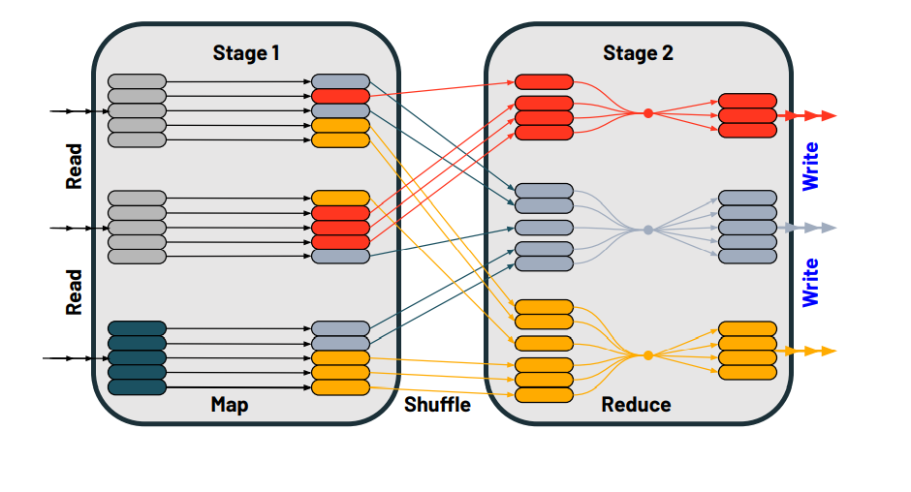
Then we conclude the stage 2 by writing the result

Slide 41
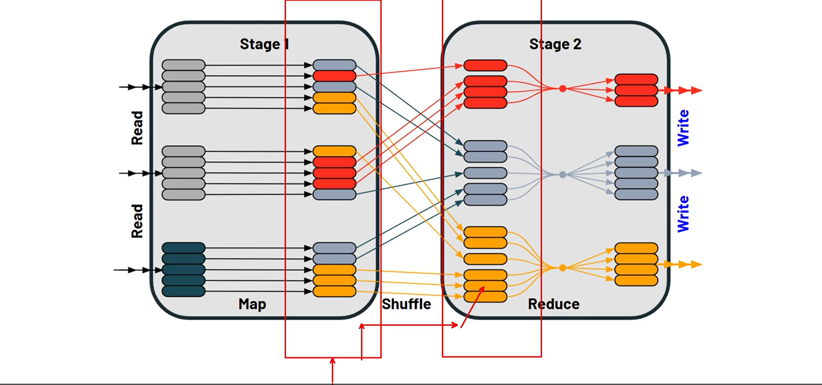
Why its a performance hit
In the map side we are proceesing the data and writing to the disk at the end of stage 1
when we read it in the stage 2, its asking the other side to read it from disk. Due to the network io
and shuffle between the different executors causes perofrmance hit

Slide 42
Different types of Shuffle operations
The distinct operation aggregates many records based on one or more keys (the distinguisher) and reduces all duplicates to one record
The groupBy / count combination aggregates many records based on a key and then returns one record which is the count of that key
The join operation takes two datasets, aggregates each of those by a common key and produces one record for each matching combination (total record count = max of a.count and b.count)
The crossJoin operation takes two datasets, aggregates each of those by a common key, and produces one record for every possible combination (total record count = a.count x b.count)

Slide 43
Common behaviour of shuffle operation
They read data from some source
They aggregate records across all partitions together by some key
The aggregated records are written to disk (shuffle files)
Each executors read their aggregated records from the other executors
This requires expensive disk and network IO

Slide 44
Points to remember
There are some cases in which a shuffle can be avoided or mitigated
Shuffles are often a necessary evil which cant be avoided
Focus on the [more] expensive operations instead
Many shuffle operations are actually quite fast
Targeting skew, spill, tiny files, etc often yield better payoffs

Slide 45
Shuffle Mitigation
The biggest pain with shuffle operations is the amount of data that is being shuffled across the cluster.
Reduce network IO by using fewer and larger workers
Reduce the amount of data being shuffled
- Get rid of the columns that you dont need
if your dataset contains 50 columns but may need only 2 columns for performing the desired operation, in that case
u will be carrying our other 48 column in the shuffle operation, thats pretty much expensive. So only slect columns
that are required before moving into shuffle
- Reduce the amount of data being shuffled
Broadcast the smaller table
- smaller table is re-distributed across the executor to avoide shuffle opeartion entirely
Best suited for tables ~10 MB, but can be pushed higher
For joins, pre-shuffle the data with a bucketed dataset
Employ the Cost-Based Optimizer
- Triggers other features like auto-broadcasting based on accurate metadata(register statistics about the table)

Slide 46
optional

Slide 47
Shuffle Mitigation - BroadcastHashJoins
Let’s review how the BroadcastHashJoin works...
Lets assume we have two tables that we want to join based upon some common column
Table 1
Table 2

Slide 48
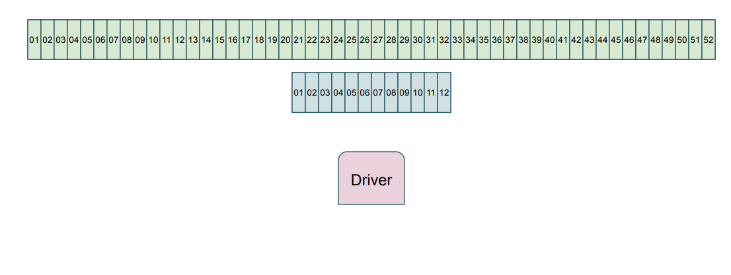
During planning the driver will partition our two datasets

Slide 49
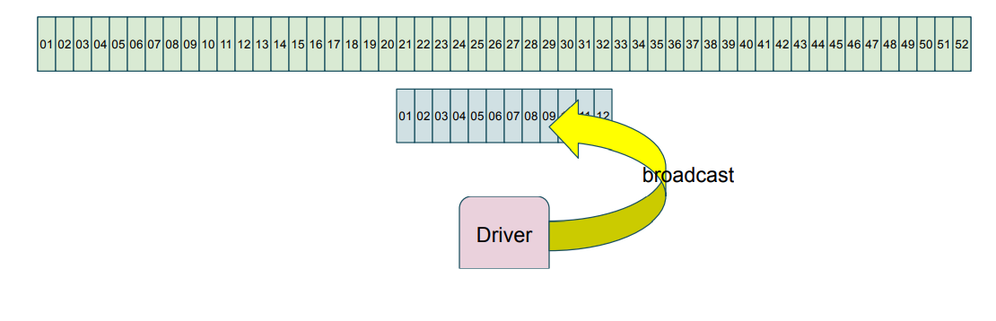
Because the Table 2 is < 10 MB, the Driver plans a BroadcastHashJoin

Slide 50
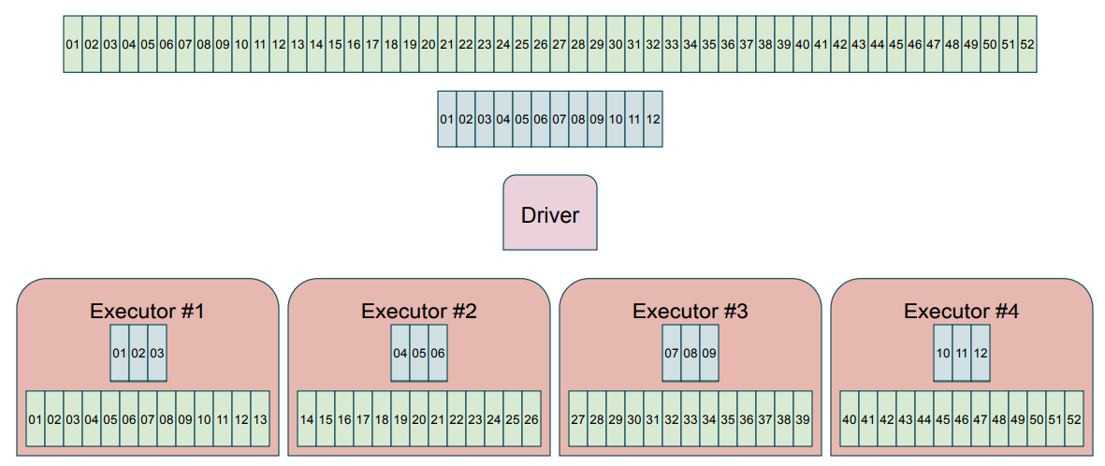
Each executor in turn reads in their assigned partitions, In a traditional join, we would proceed with the map and shuffle

Slide 51
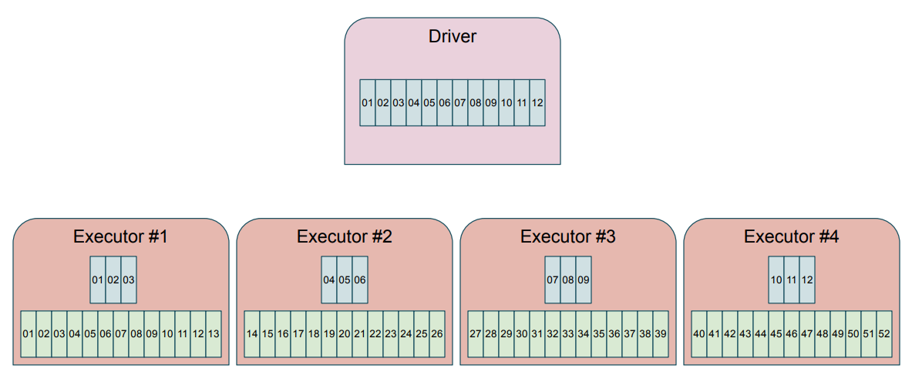
Instead, every partition of the the broadcasted table is sent to the driver, thats why driver had be properly coinfigured to hadle the broadcast. If the broadcast table is 10mb any driver should be able to handle it, if its a 10 GB then thats the bottleneck

Slide 52
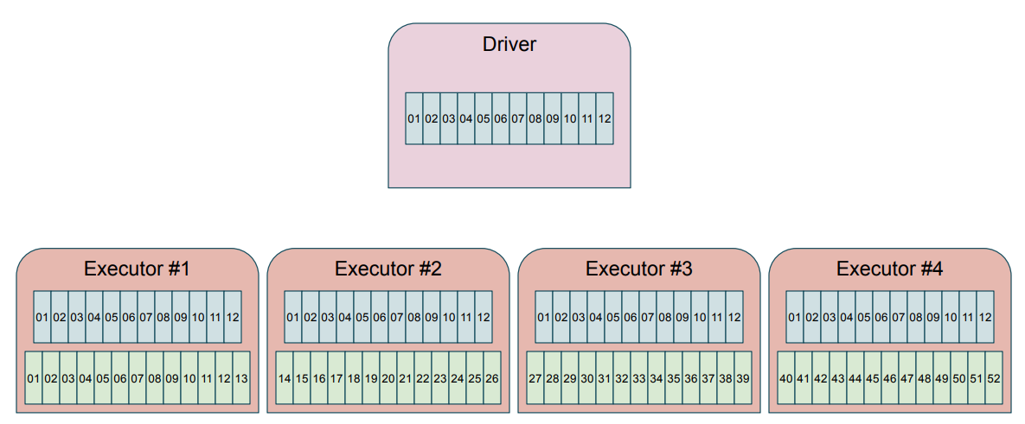
Next, a copy of the entire table is sent back to each executor

Slide 53
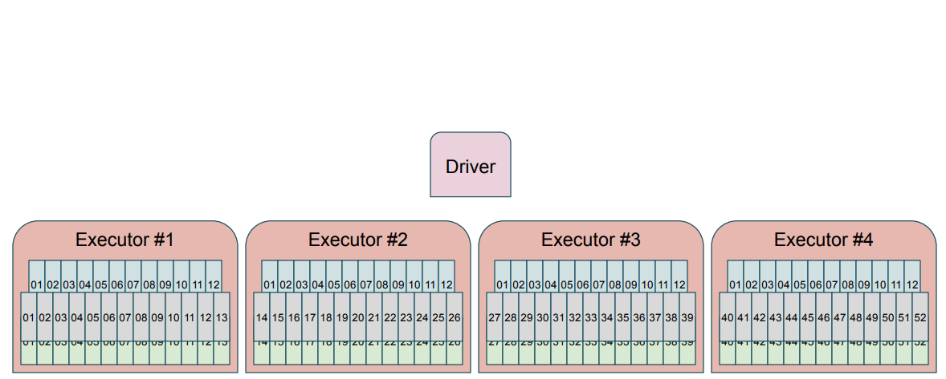
Lastly, each executor is able to join any of its records because it has a complete copy of the broadcasted table, eliminating the expensive shuffle operation

Slide 54
Points to remember:
BroadcastHashJoin induces high level of netwrok IO between the Driver and Executors
With small tables (e.g. around 10 MB), the cost is lower than the exchange
When pushed to higher limits (say 100 MB), the balances start to shift
Similarly, many empty partitions can adversely affect the BHJ
The Driver & Executors both require enough RAM to receive the fully broadcasted table
Performance depends on the relative scale of the left and right table

Slide 55
Shuffle Mitigation - Bucketing
The goal is to eliminate the exchange & sort by pre-shuffling the data
The data is aggregated into N buckets and optionally sorted [locally]
The result is then saved to a table and available for subsequent reads
The bucketing operation pays for itself if the two tables are regularly joined and/or not reduced with some sort of filter

Slide 56
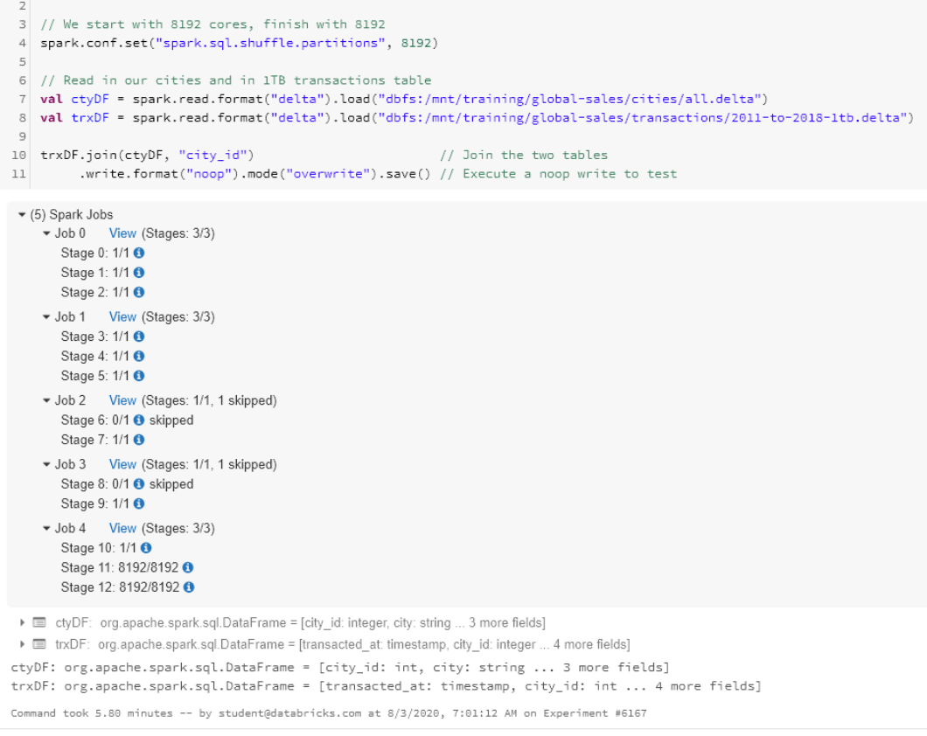
Baseline:

Slide 57
bucketing In order for it to work we need to, we need to use apache spark meta store, in order to store metadata about where each partition is, so that it can efficiently execute and perform join operation
To work properly, both tables must have the same number of buckets
You must predetermine the number of buckets
The general rule is one bucket per core

Slide 58
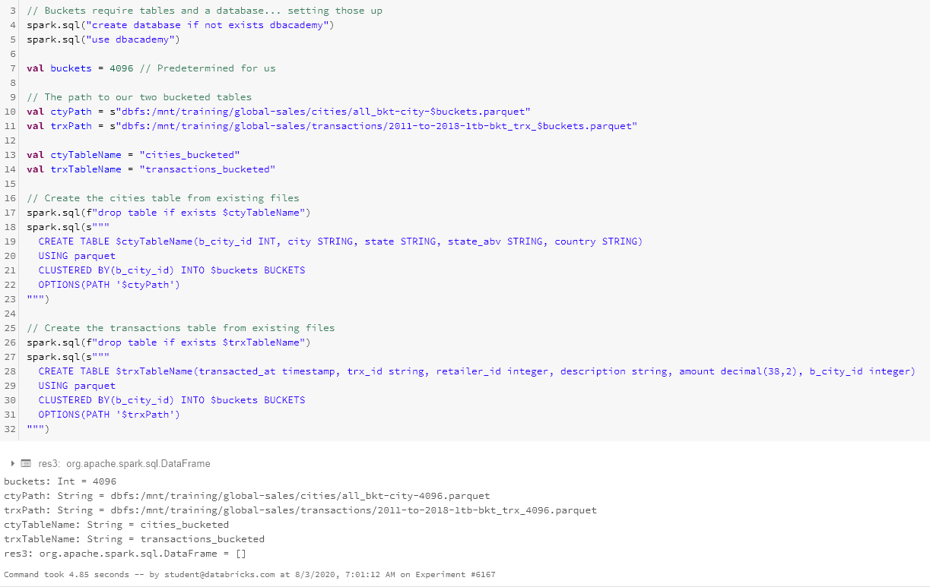
Bucketing

Slide 59
